Slide 1
The Tabernacle
Exposition of Exodus 26
Saturday PM 28th January 2017
“WRITTEN IN THE SAND”

Slide 2
Introductions
“The new is in the old concealed, and the old is the new revealed” - Augustine
The Tabernacle is very important to God
Exodus 25 – 40, Hebrews 8 and 9,

Slide 3
Overview – Exodus 26
God instructed Moses to prepare the covering of the Tabernacle – the embroidered sheets, the panels of goat’s hair, the dyed ram’s skin and the badger skin roof
God clarified the dimensions and detail of the frame of the Tabernacle
God specifies the division of the space in the Tabernacle

Slide 4
Tabernacle Covering

Slide 5
Dimensions and Materials

Slide 6
Dimensions and Materials
The Frame (the walls and their support base) of the Tabernacle were made of acacia wood, pure gold and silver
The Frame had a total of 48 panels with five poles attached to each side to support them all covered in pure gold…see video

Slide 7
Dimensions and Materials
The Holy of Holies was separated from the Holy Place by a square veil or tapestry intricately woven cherubim with blue, purple, scarlet and fine linen – hanging on four pillars of acacia wood covered in pure gold

Slide 8
Dimensions and Materials
The entrance of the Tabernacle (the Tent) was a screen facing East, it too was a woven tapestry of blue, purple, scarlet and fine linen but, …without the cherubim design on it; hanging on five pillars of acacia wood covered in pure gold

Slide 9
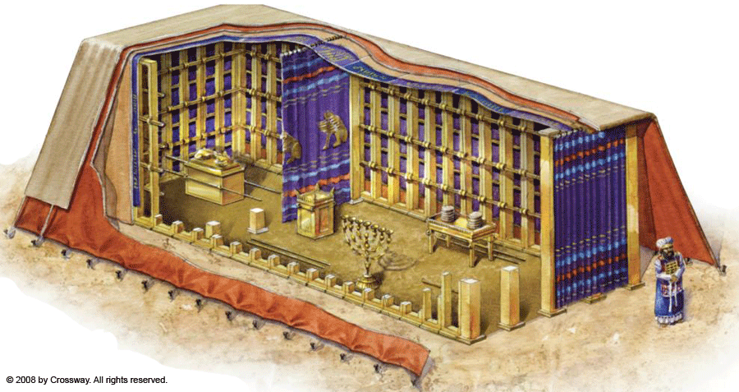
Items of Furniture

Slide 10
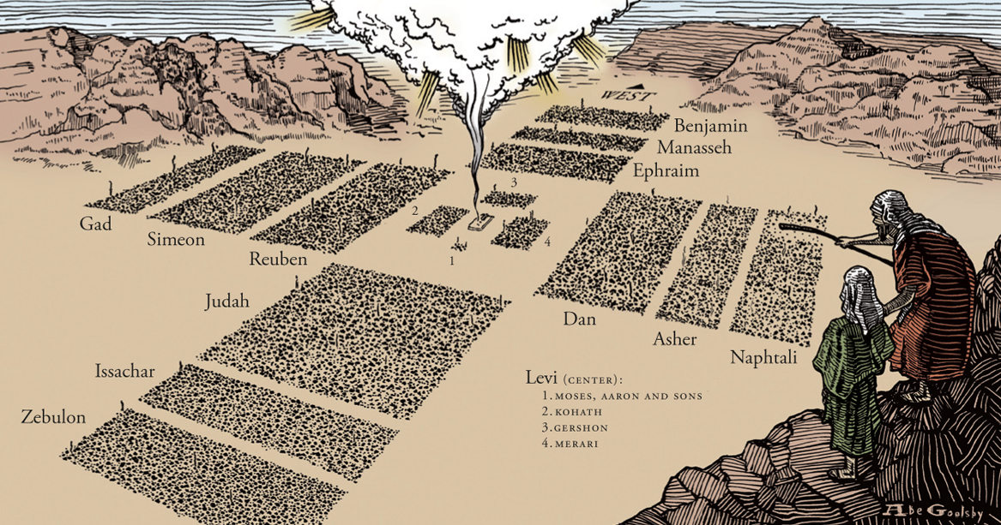
God Bless You

